Slide 1

KG English Department by
Mariam Hany

Slide 2
The Curriculum
O Level
Discover
Splash
Phonics:
Jolly Phonics
Bricks: First Spotlight on Reading

Slide 3
Booklets (Portfolios)
Booklets are done at home.
(Answer keys are sent regularly.)
Booklets come to school for correction when asked for.
Discover Portfolio
Reading Booklet
Handwriting Booklet
There will also be worksheets for Splash and Phonics sent home.

Slide 4
What teachers do in class:
Introduce vocabulary: flashcards- power points- videos- songs- games…
Introduce sentence structure: games and activities
Explain new ideas: games and activities
Help students reach and achieve all life skills
Work in books with students

Slide 5
The Agenda
The agenda will be sent on the following dates:
Splash: Thursday
Discover and Spotlight on Reading: Saturday
Phonics: Monday

Slide 6
The Agenda Includes
Main ideas discussed in class
Power point presentations
Vocabulary words
Sentence structure
Links for videos and songs
Links for online games
Homework

Slide 7
What should parents do at home?
Check Google Classroom daily even though the agenda is sent weekly.
Help the students read the vocabulary words through games and watching power points.
Let the students watch the videos and links sent in the agenda.
Make sure that the students do their homework on time.
Prepare discussions with their children
Help their child to prepare projects
Help their child prepare and study for assessments. (We have 2 assessments per term)

Slide 8
Competitions:
Reading Challenge
Speaking Competition
(Sparkling Stars)
Spelling Bee

Slide 9
Teachers:
KG 1 A and B
Ms. Irene Talaat (Discover+ Phonics)
Ms. Merna Ramzy
(Splash+ Bricks)
KG 1 C and D
Ms. Yasmine Samy (Discover+ Phonics)
Ms. Merna Hany
(Splash+ Bricks)

Slide 10
KG Activities

Slide 11
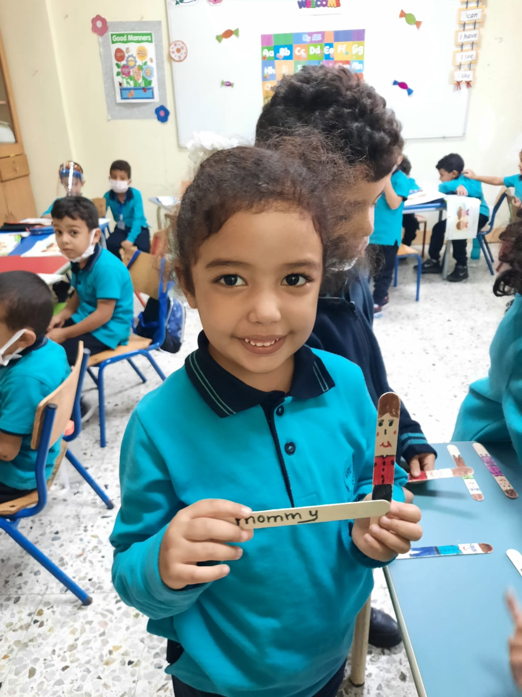
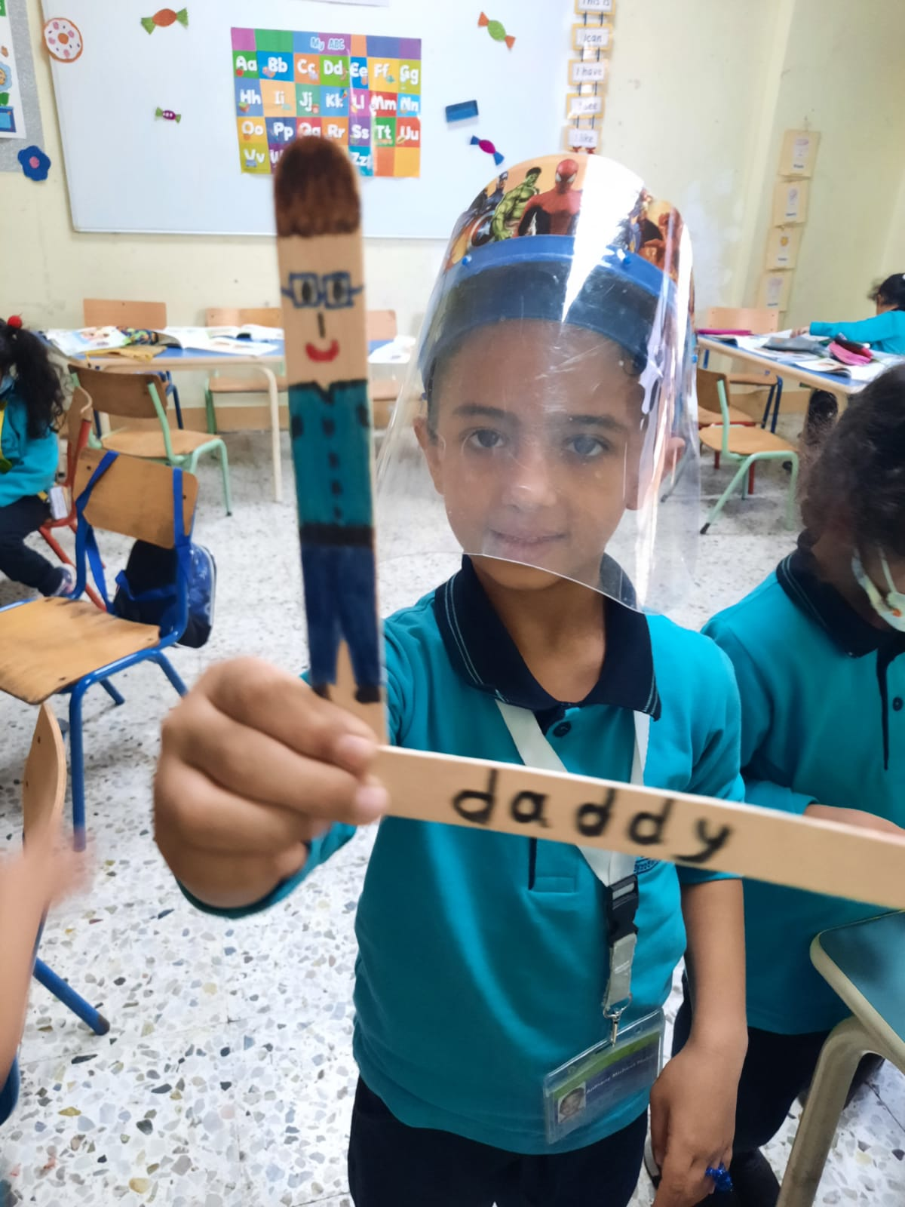
KG 1
Matching Family members words and pictures

Slide 12
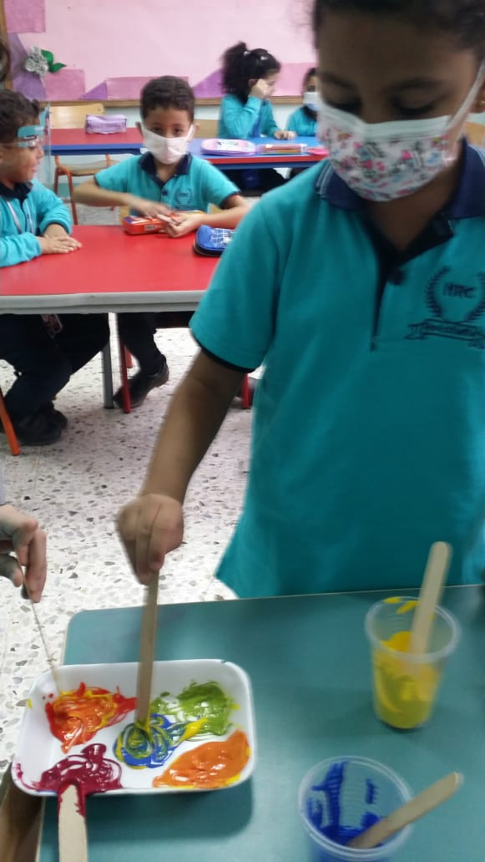
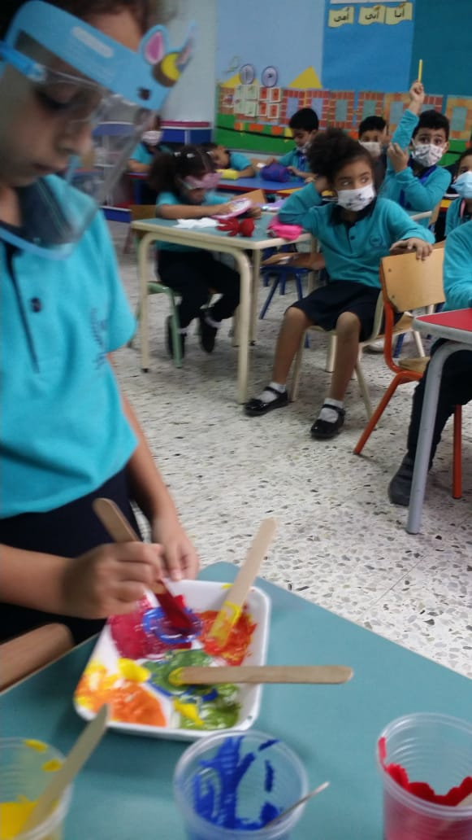
KG 1
Colour Mixing

Slide 13
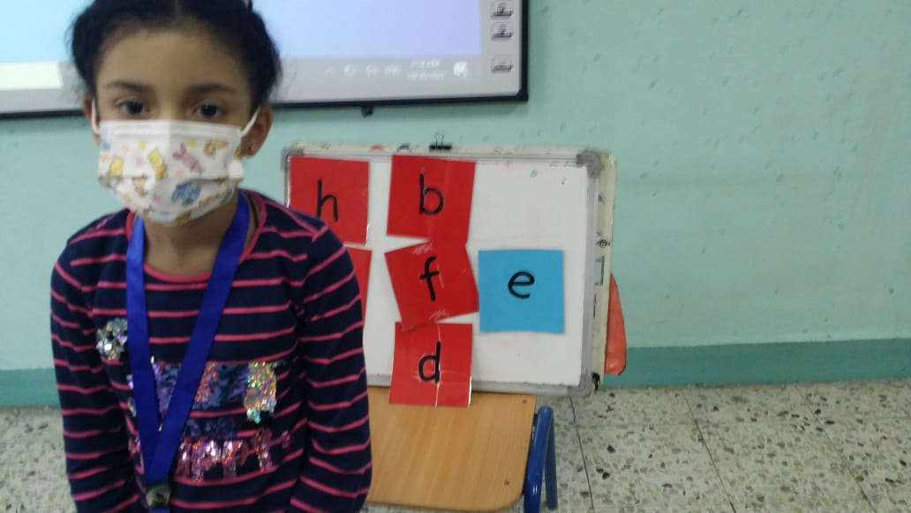
KG 1
Find the missing sound
(Some sounds are displayed in front of the students, then the teacher removes one of them and they guess what the missing sound is.)

Slide 14
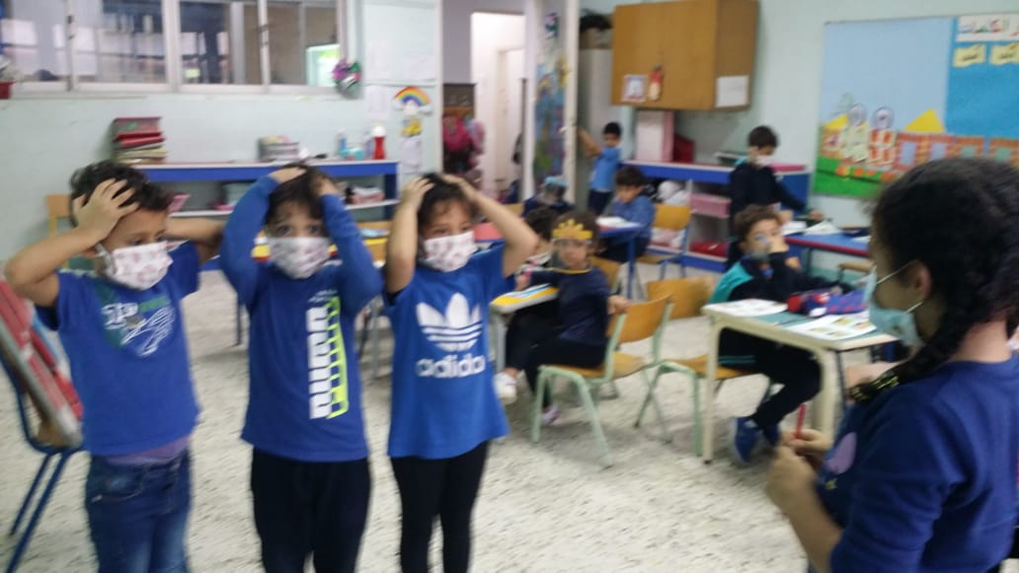
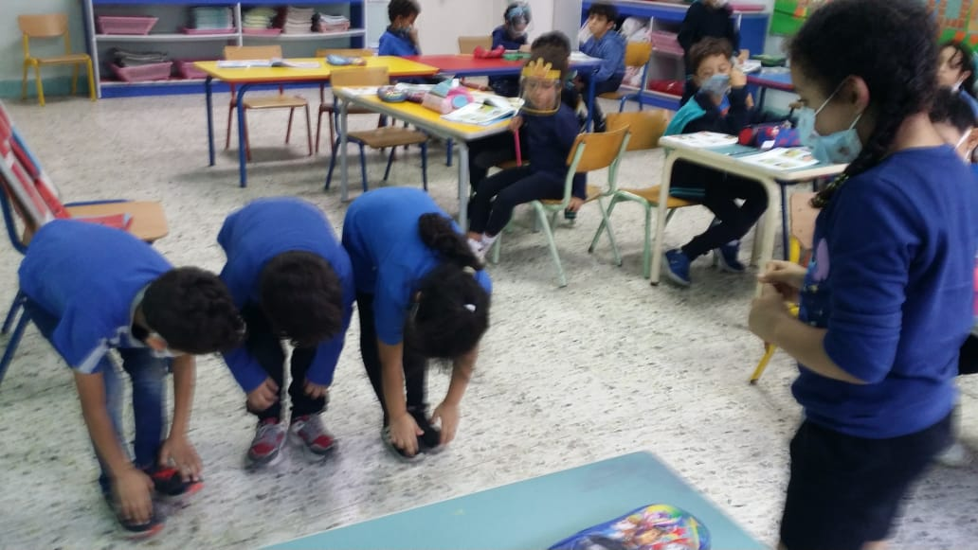
KG 1
Body Parts
One of the students acts as the teacher and asks the other students to point to their body parts as a kind of revision.

Slide 15
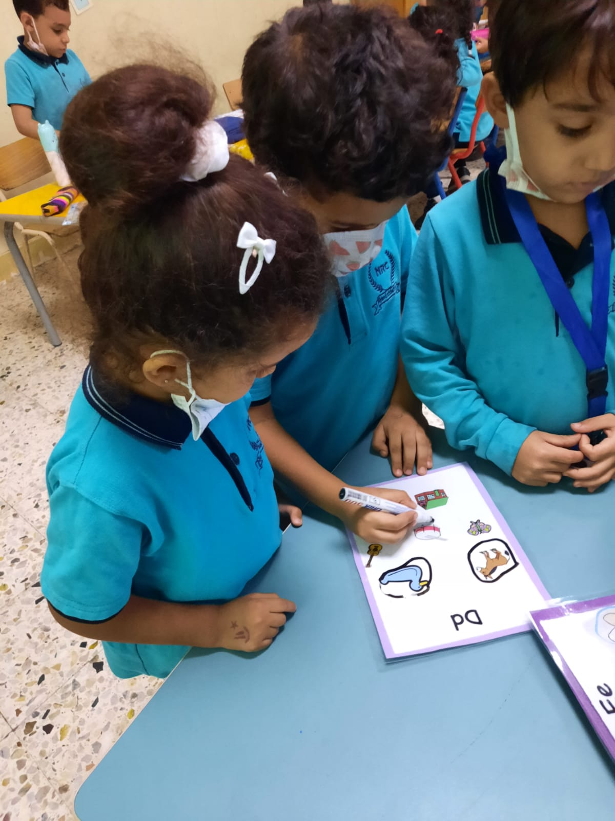
KG 1
Circle words with the same beginning sound

Slide 16
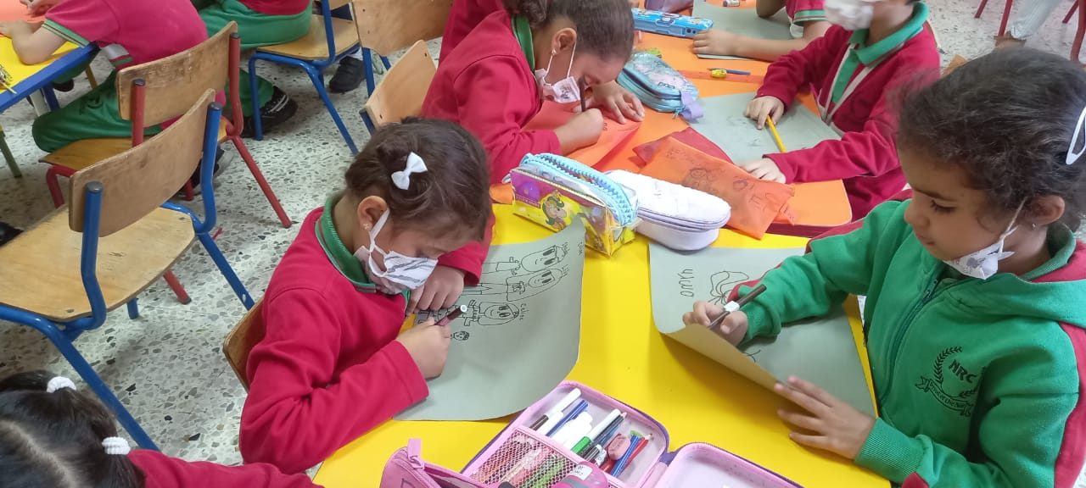
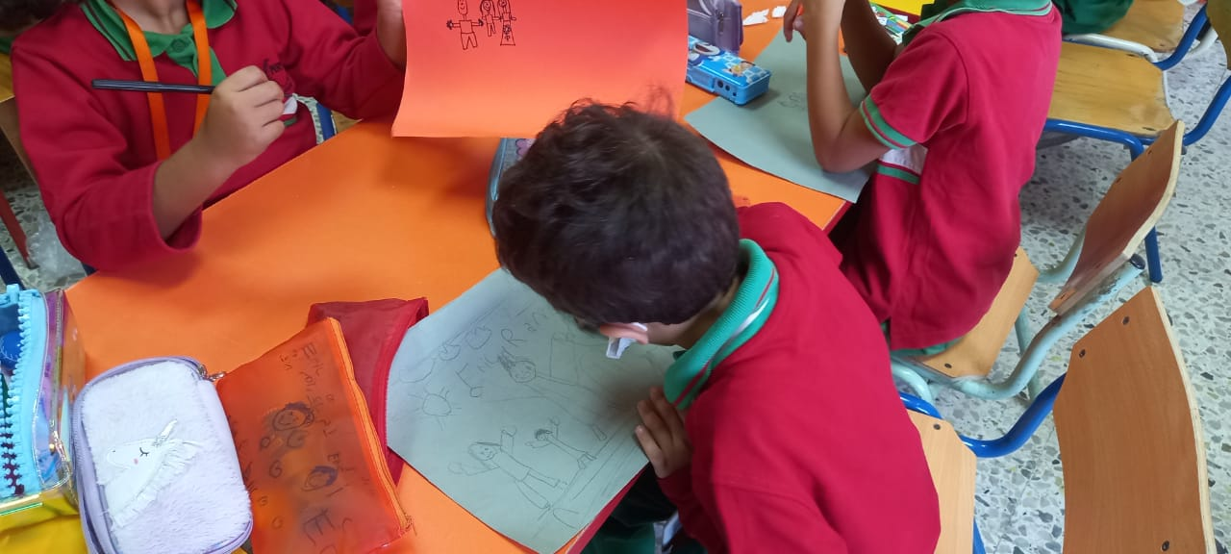
KG 2
Drawing extended family

Slide 17
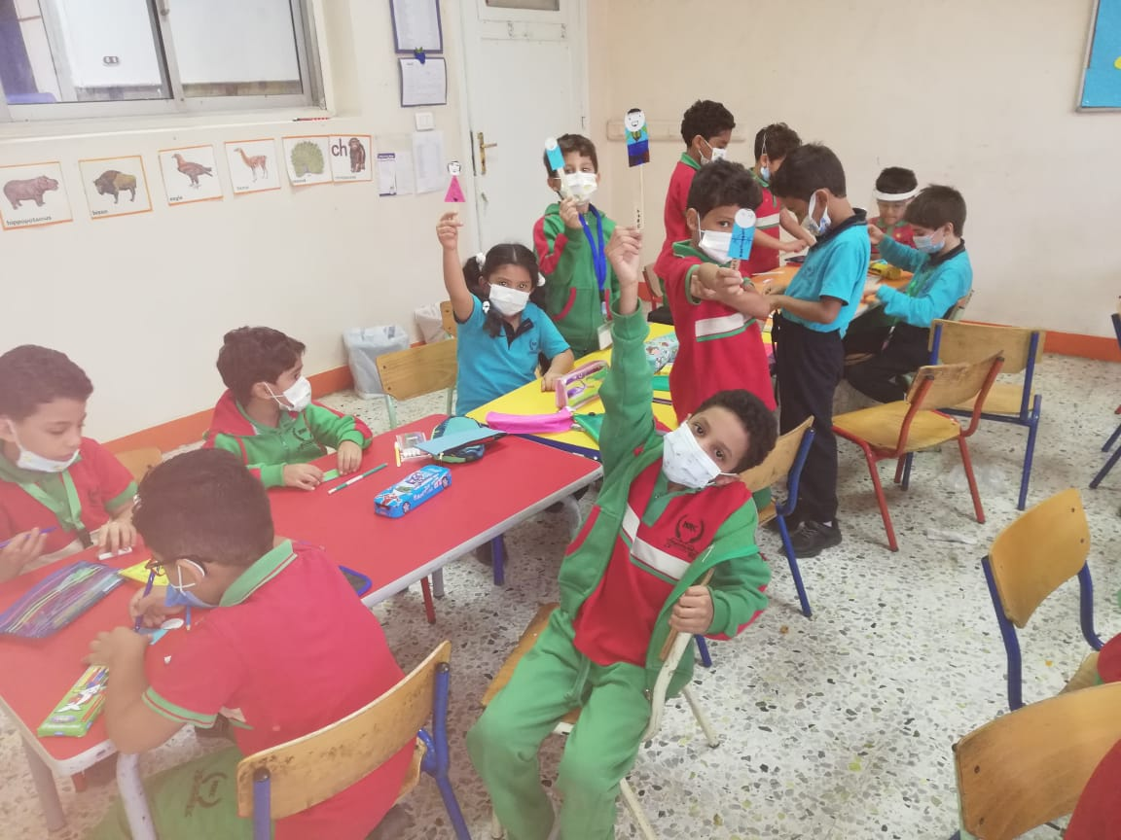
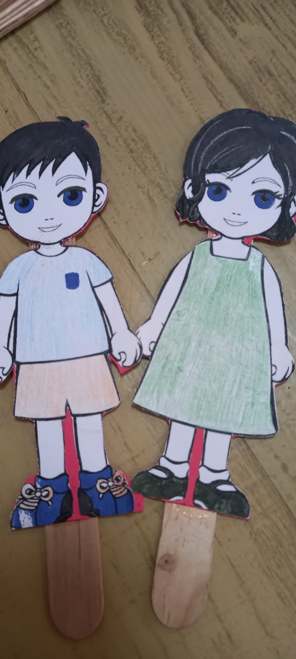
KG 2
Puppets

Slide 18
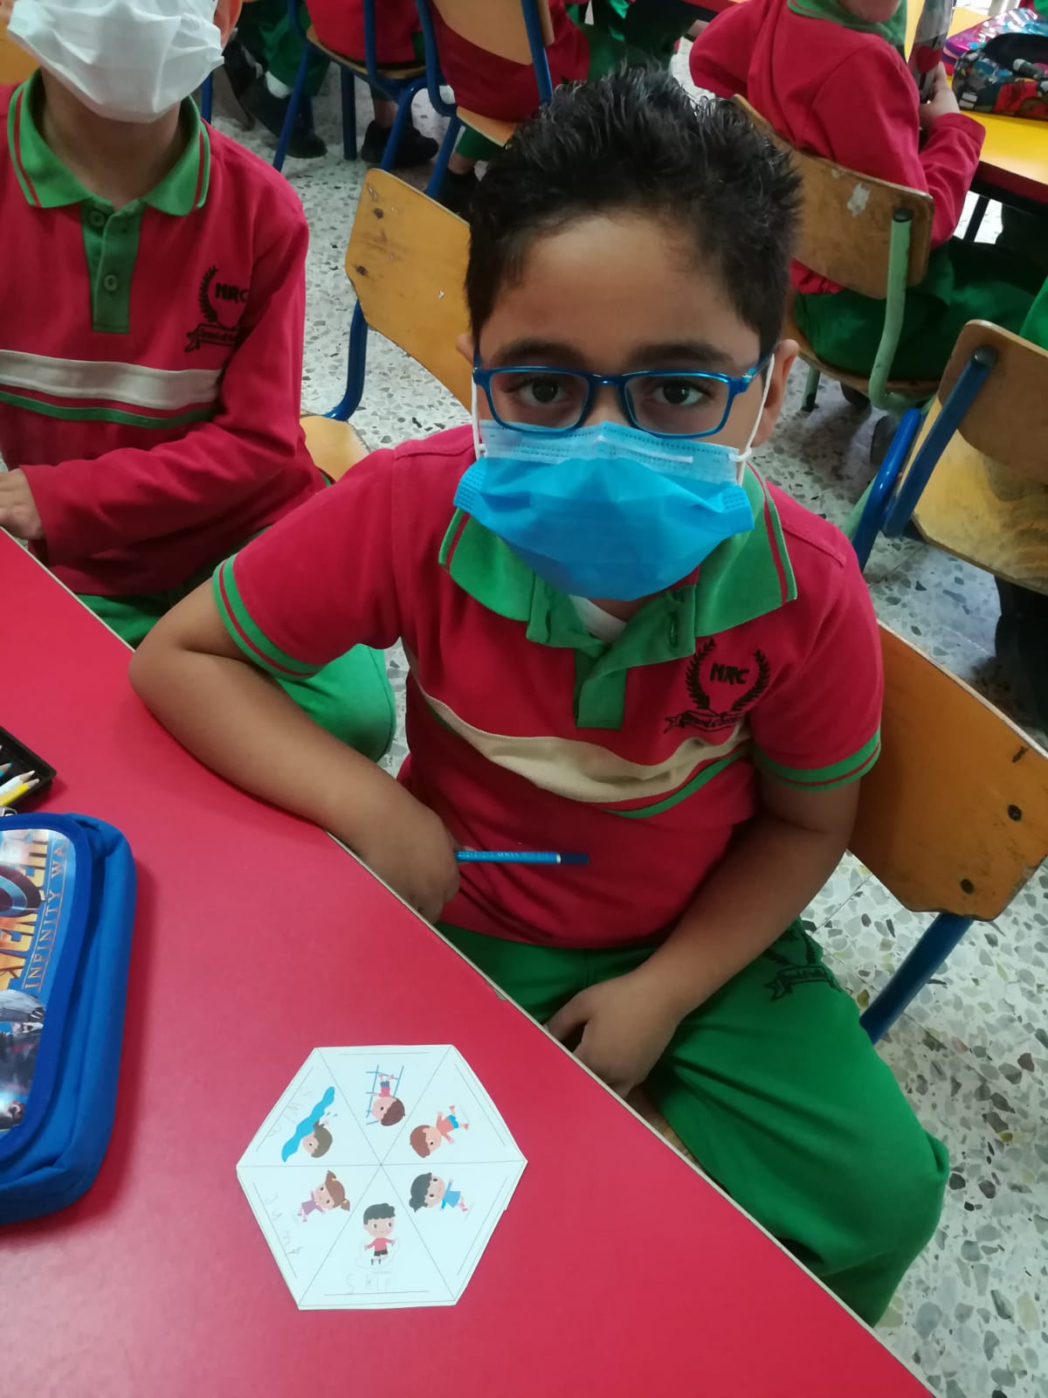
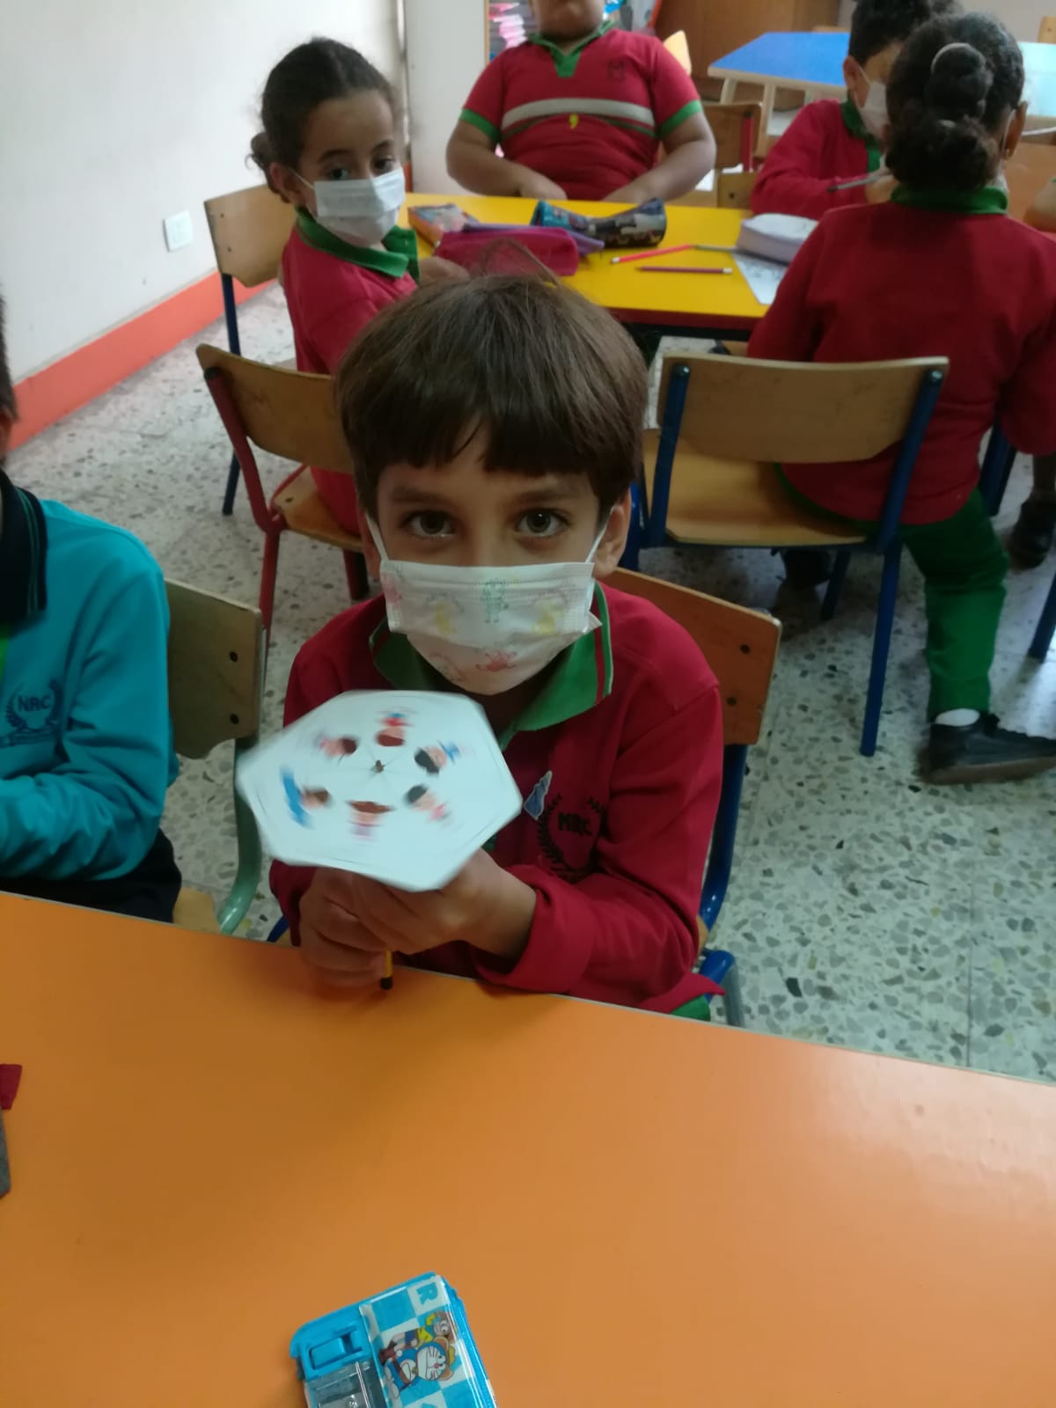
KG 2
Action Words Spinner
(Book Activity)

Slide 19
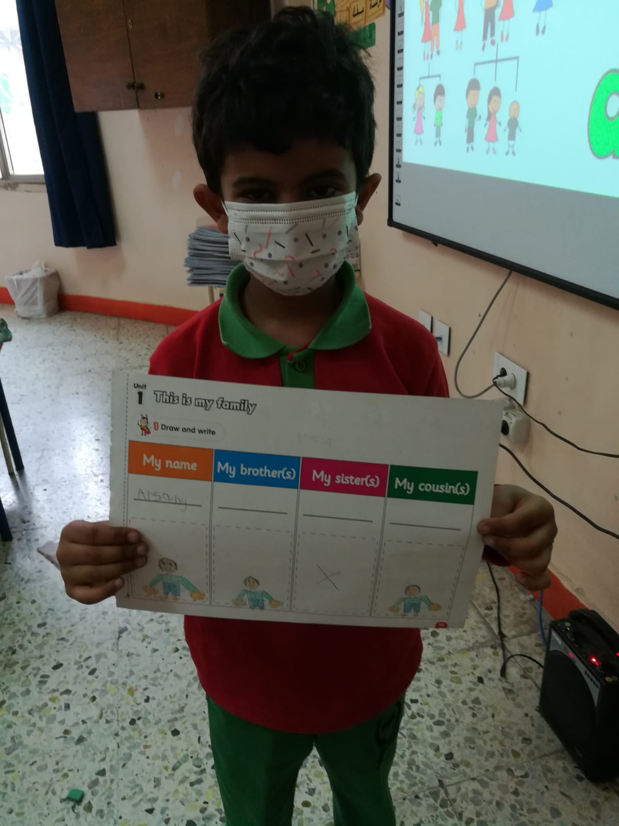
KG 2
Family Members
(Book Activity)

Slide 20
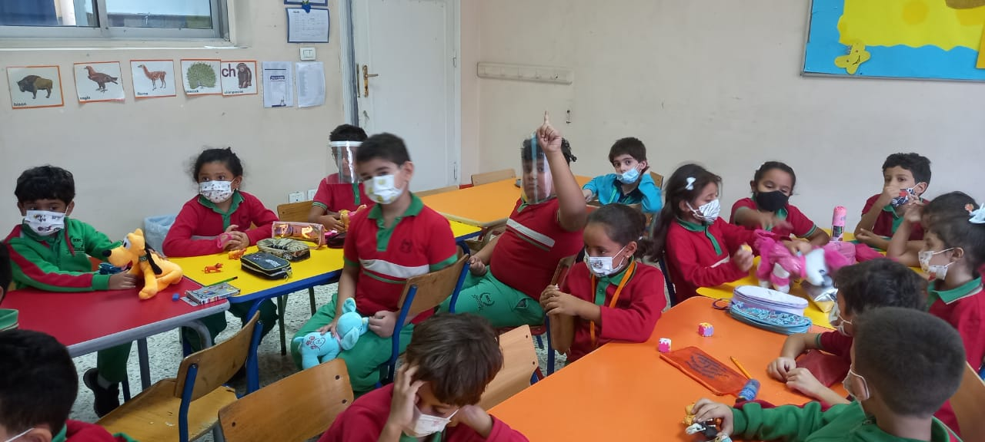
KG 2
My Favorite Animal

Slide 21
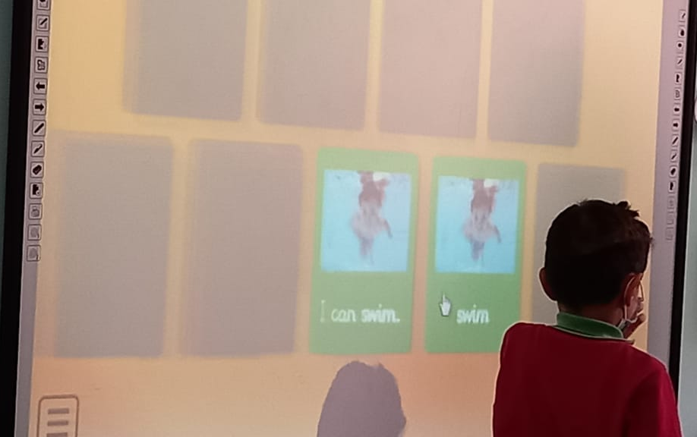
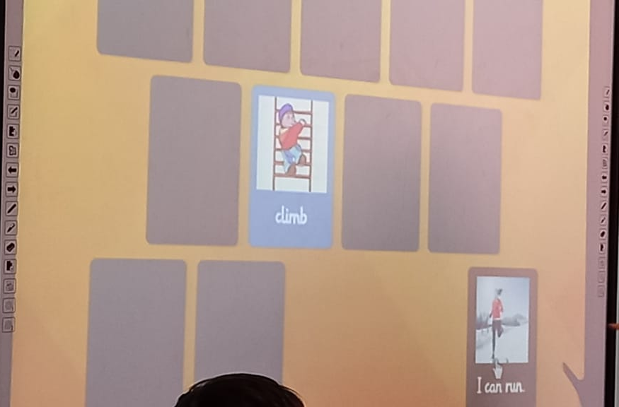
KG 2
Memory Game

Slide 22
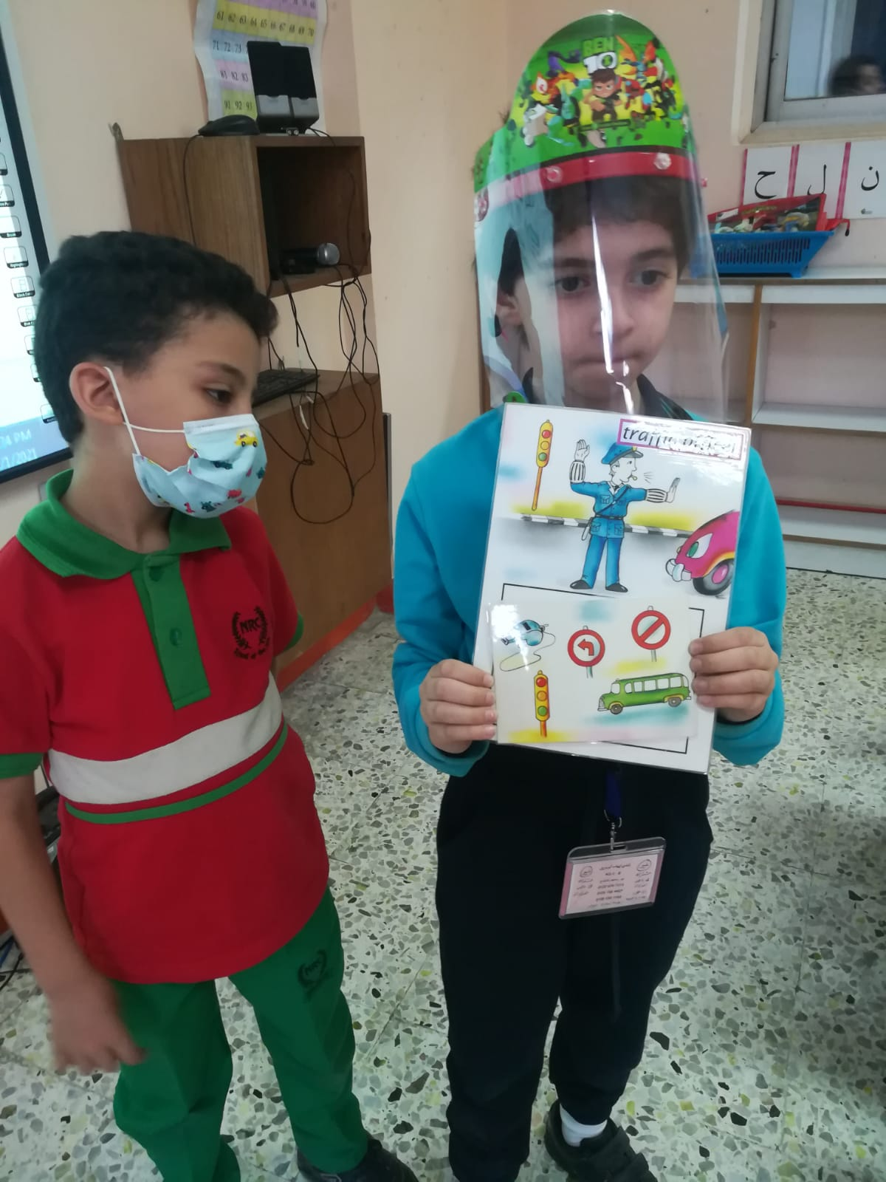
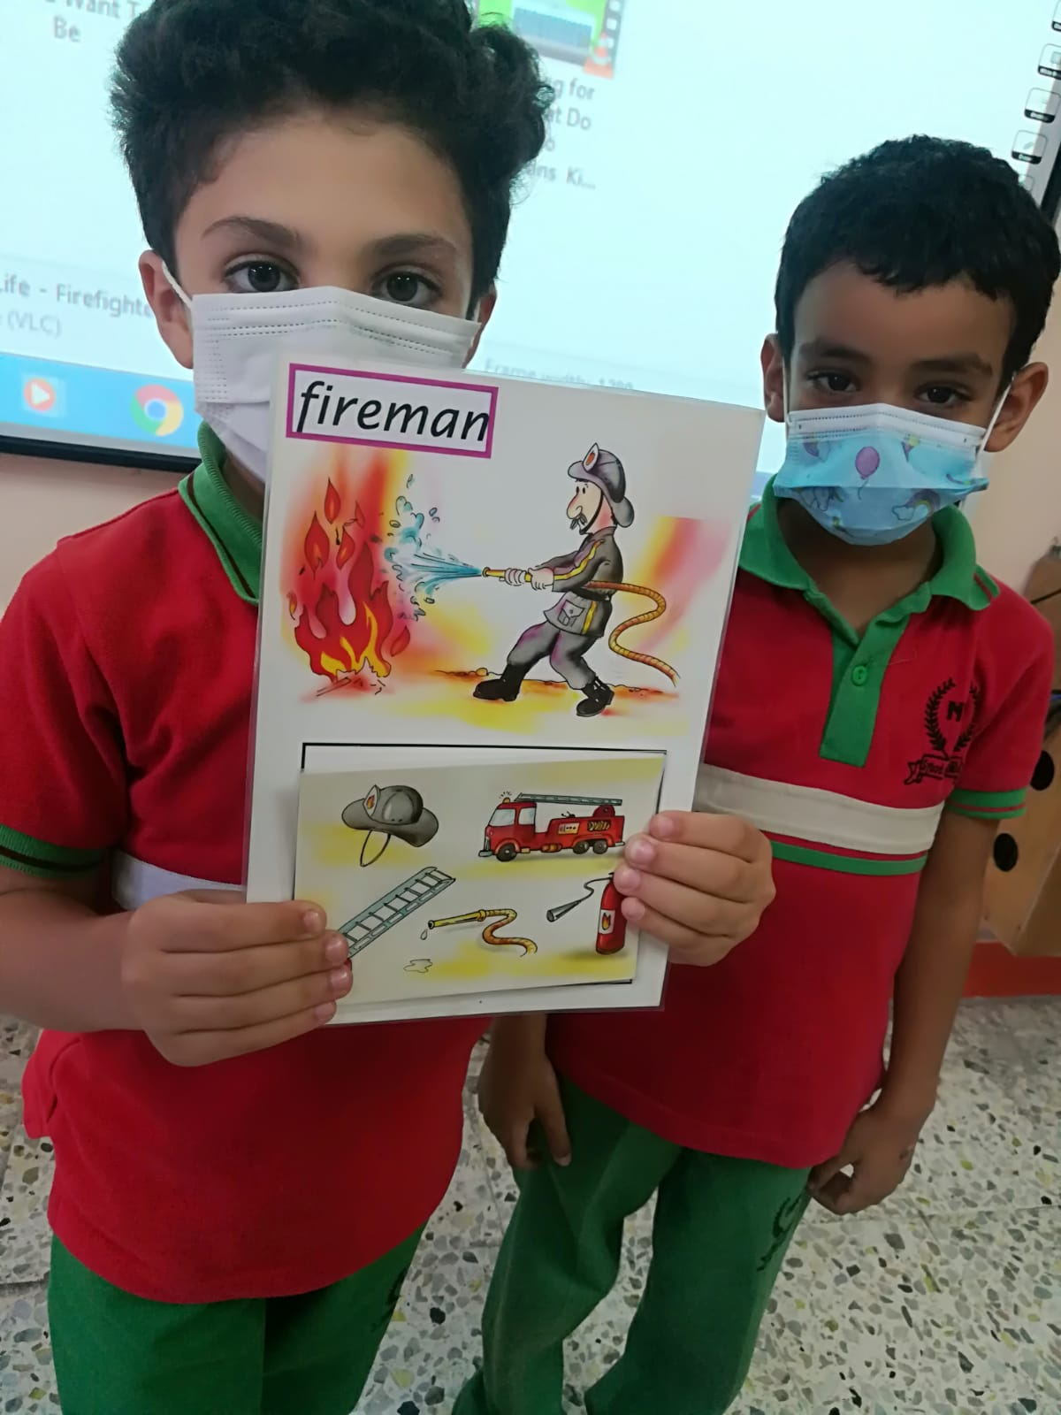
KG 2
Matching jobs and tools

Slide 23
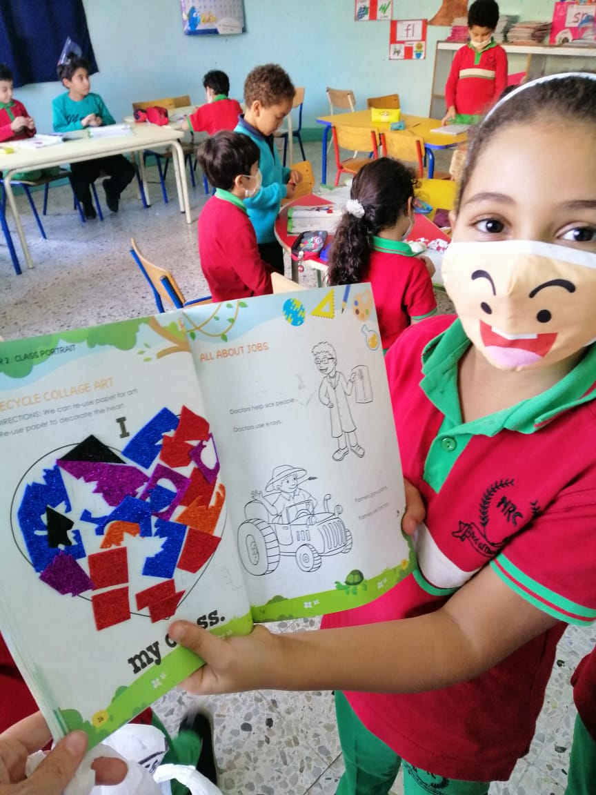
KG 2
Recycling
(Instead of throwing away bits of paper, they were used as collage)

Slide 24
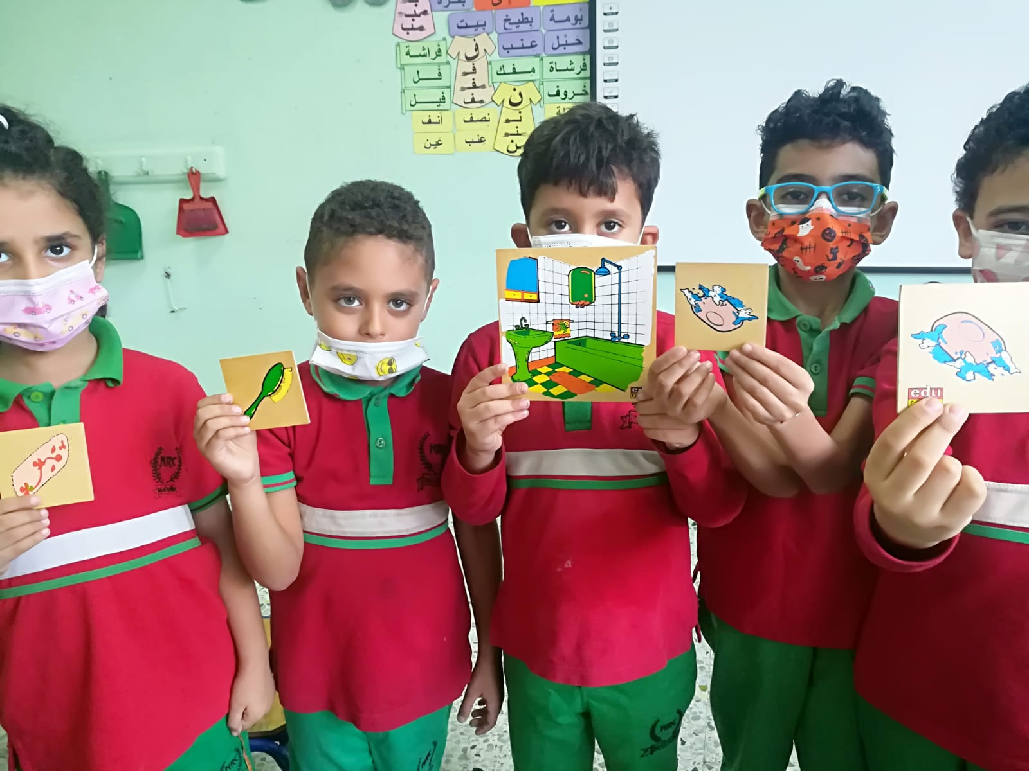
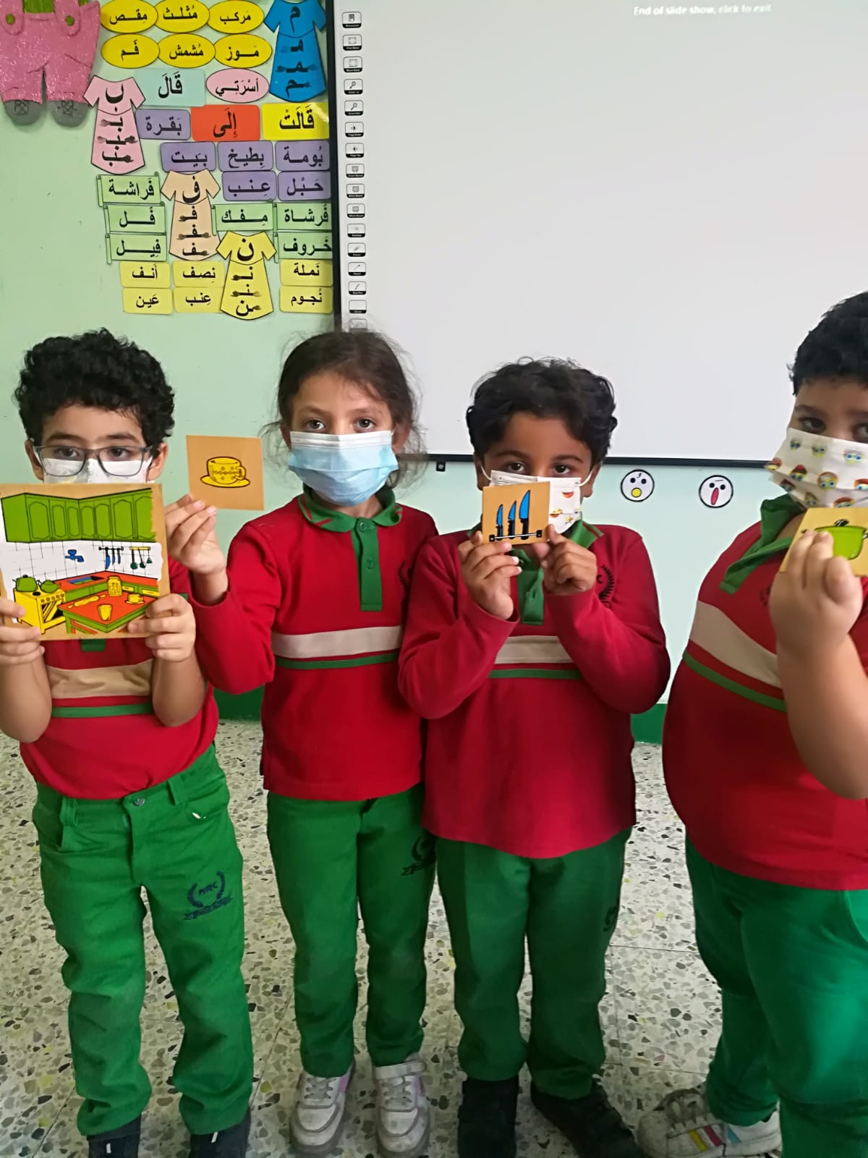
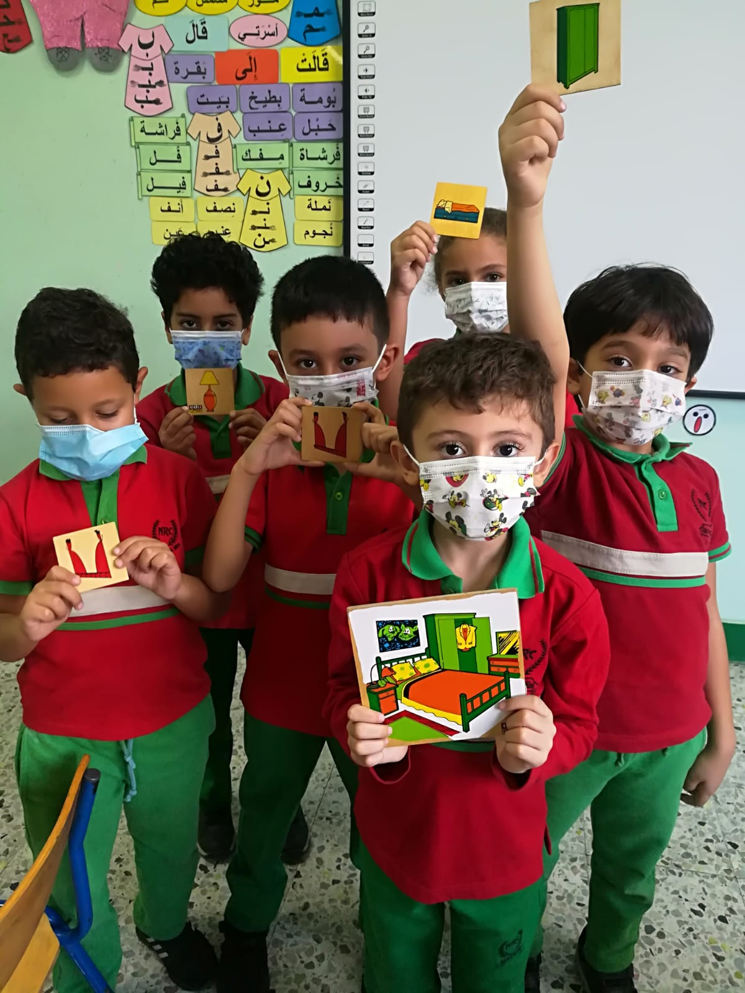
KG 2
Rooms of the house
(Classification)

Slide 25
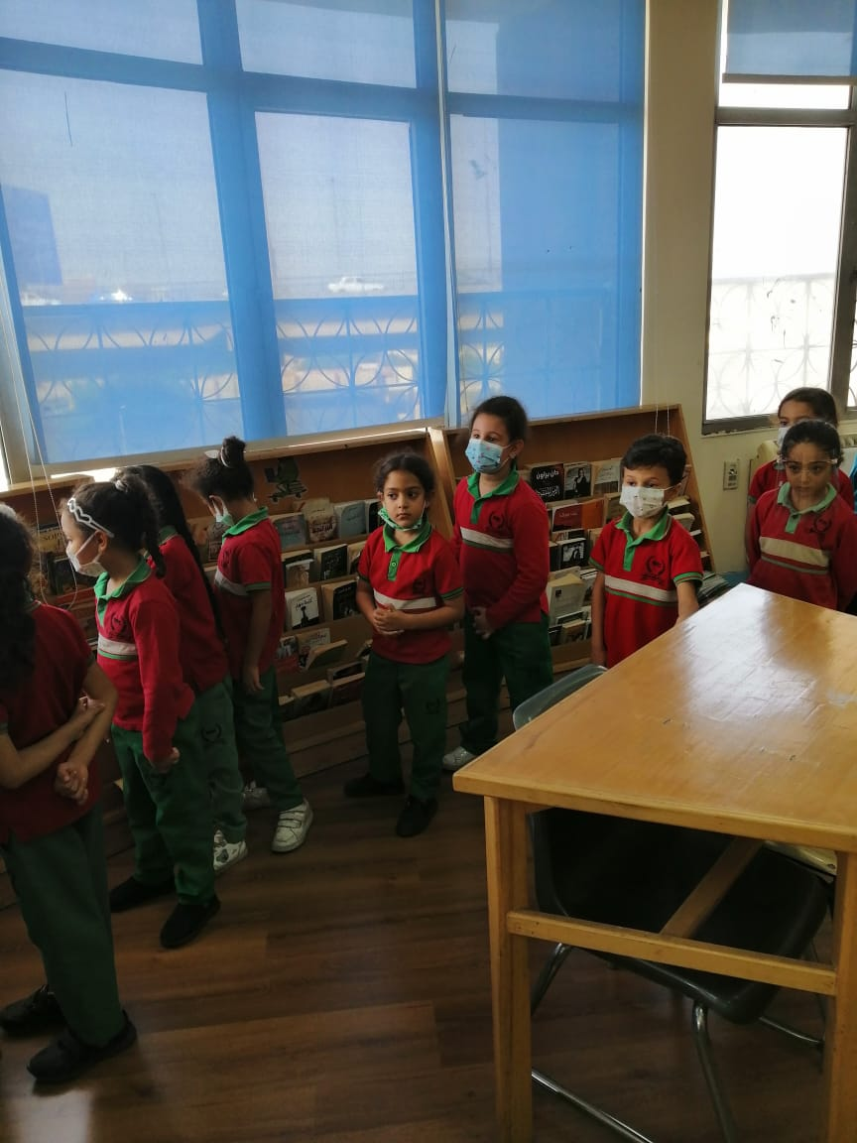
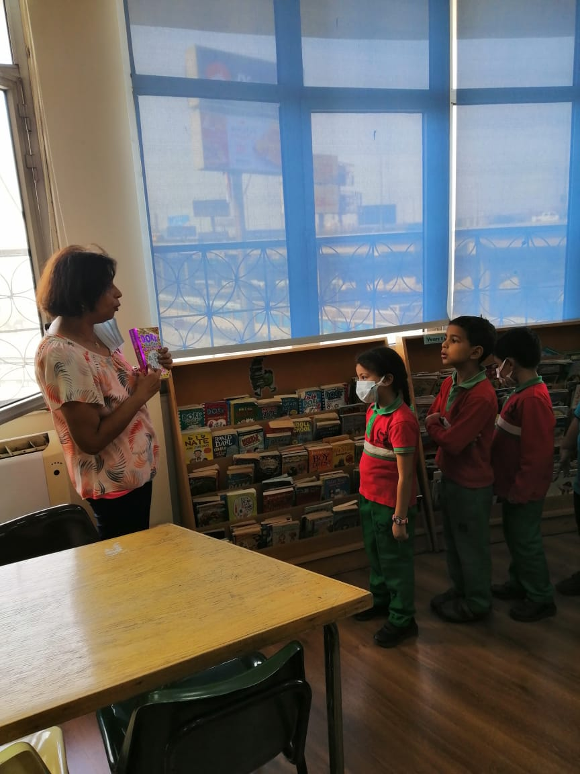
KG 2
Visit to the library

